Slide 1
Moodle using surveys and glossaries
By Kris
(feel free to decorate while I set up….I’ll get you started)

Slide 2
By the end of this session you will be able to:
Understand when you would use a survey
Insert a survey into your Moodle page
Use a survey to collect information
Understand the value of using a glossary as part of your Moodle page
Insert a glossary and make effective use of it
I’m going to start by going through a quick presentation, then I’ll do an application share and then we will practice.

Slide 3
But first…..
How would you describe yourself in terms of using Moodle previous to this course?
(use the pull down voting tool in Collaborate)
A: Never even heard of it!
B: Seen it but not used it myself.
C: Tinkered around in it here and there.
D: Used it many times but don’t know the tricks.
E: Fairly proficient at using it in the classroom.

Slide 4
For this session you will need:
To login to Moodle and choose “(your name)’s classroom” then “Add a course” (we may have done this for someone else’s presentation so a test one will work for now – take a minute to set one up if necessary)
Collaborate open on the side in order to view this slideshow
Patience with me…..I’m just a beginner! ☺

Slide 5
Surveys
At this point (correct me if this has changed) there are only a few pre-made surveys for use in Moodle. These surveys talk generally about online use and experience to help teachers get a feel for their class.
At some point they promise that you will be able to make your own surveys – which is where I think the real value of this would lie – but for now you’ll have to use the polling option in Collaborate, the Question Bank or Quiz (as Breanne shared with us)

Slide 6
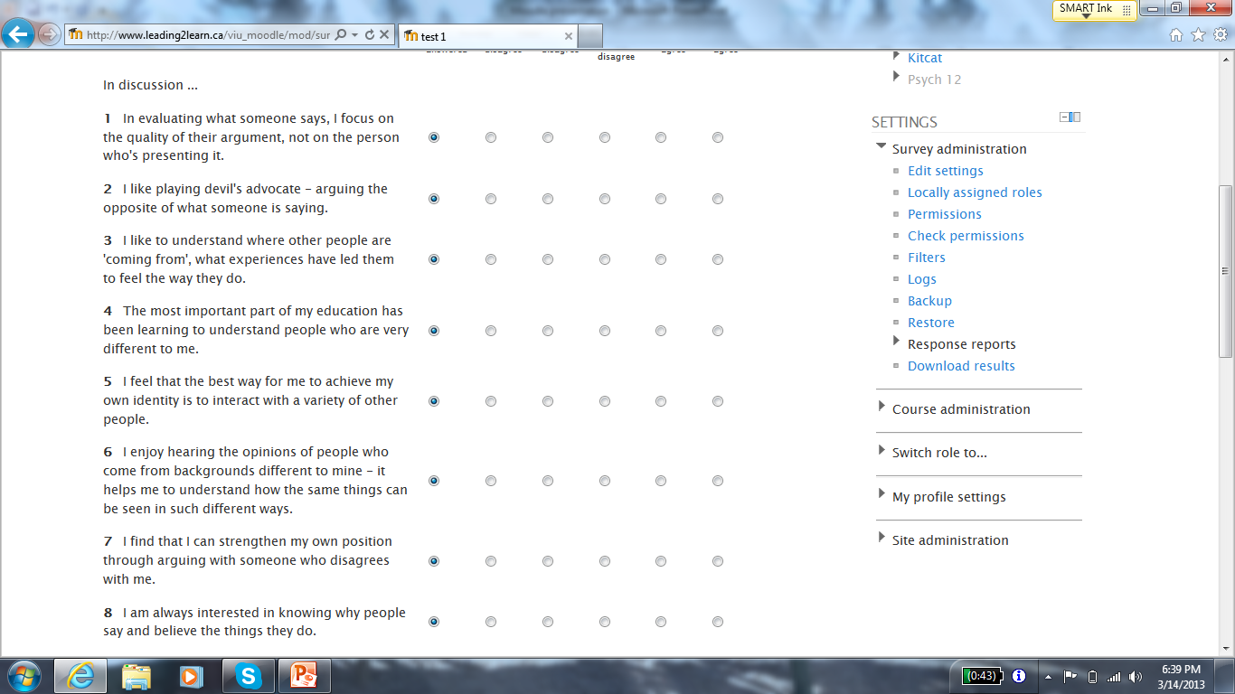

Slide 7
The first thing you want to do is click “Turn editing on” near the top just off center to the right. This will allow you to see all of the options that you can do to change the page.
Next, under whichever topic you are wanting to add to, click “Add an activity” and scroll down to Survey.
Now you’ll have to name it and choose what kind of survey from the list. You can describe it if you like and split students into groups as well.
Finally, click on “Save and return to course” and it will take you back to the builder page. You can then click on the survey title and it will open up in that unit.

Slide 9
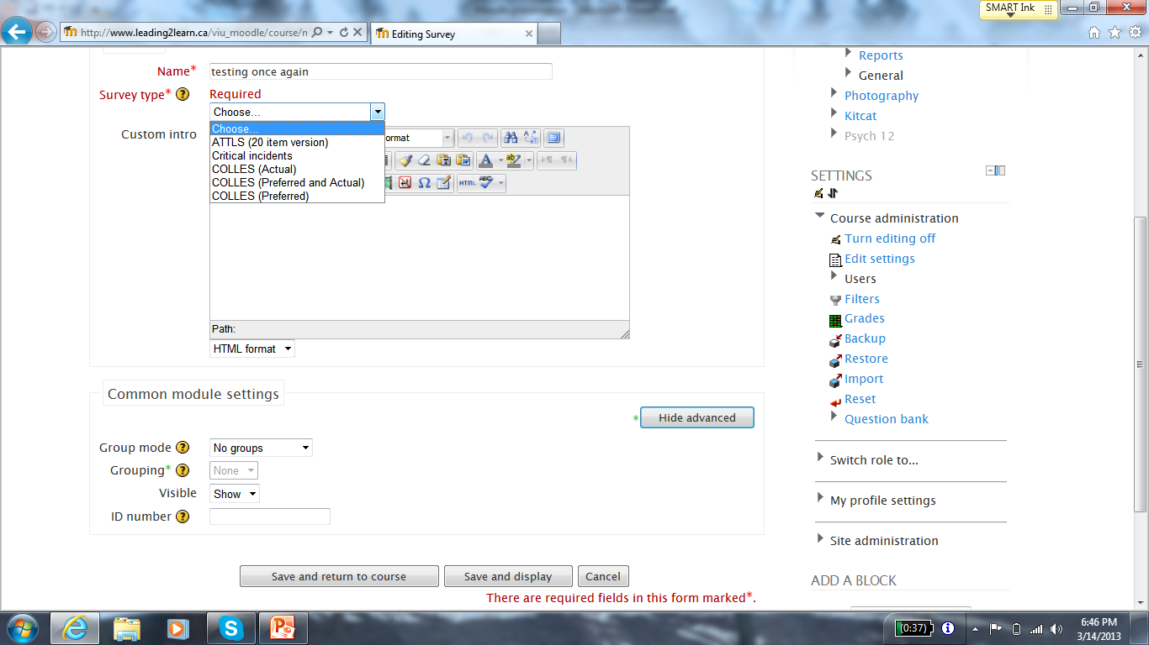

Slide 10
A further option in taking surveys:
If you are interested, you can set up a survey with your own entries by using the Feedback option. To access this option go to: Settings > Site Administration > Plugins > Activity modules > Manage activities (we don’t seem to have this option here but in a newer version of Moodle it says that you should. I would hope so because it looks pretty cool…..

Slide 11
Really quickly….
How are we doing? Any questions?
Ready to proceed?
Put a check mark in the polling tool if you are ready to keep going…..

Slide 12
Glossary
A glossary can be used in Moodle much like we have used Wiki’s in our classes – to build class collections of terms or items that everyone can see, edit and refer to
Glossaries can be open to all students in the class or have limited privileges for editing (typically limited to the teacher)

Slide 13
Similar to the steps we followed to add a survey:
Make sure that you have chosen to “Turn editing on” near the top of the page.
Again click “Add an activity” and scroll down. This time choose Glossary.
Now you’ll cam name and give a short description of it.
Finally, click on “Save and return to course” and it will take you back to the builder page. You can then click on the glossary title and it will open up in that unit.
You and your students can add to the glossary at any time by clicking on it, choosing a letter and clicking on “Add a new entry.” (I would love to do this as a class and have students ‘define’ themselves….or I might just do that in our wiki for now! ☺)

Slide 15
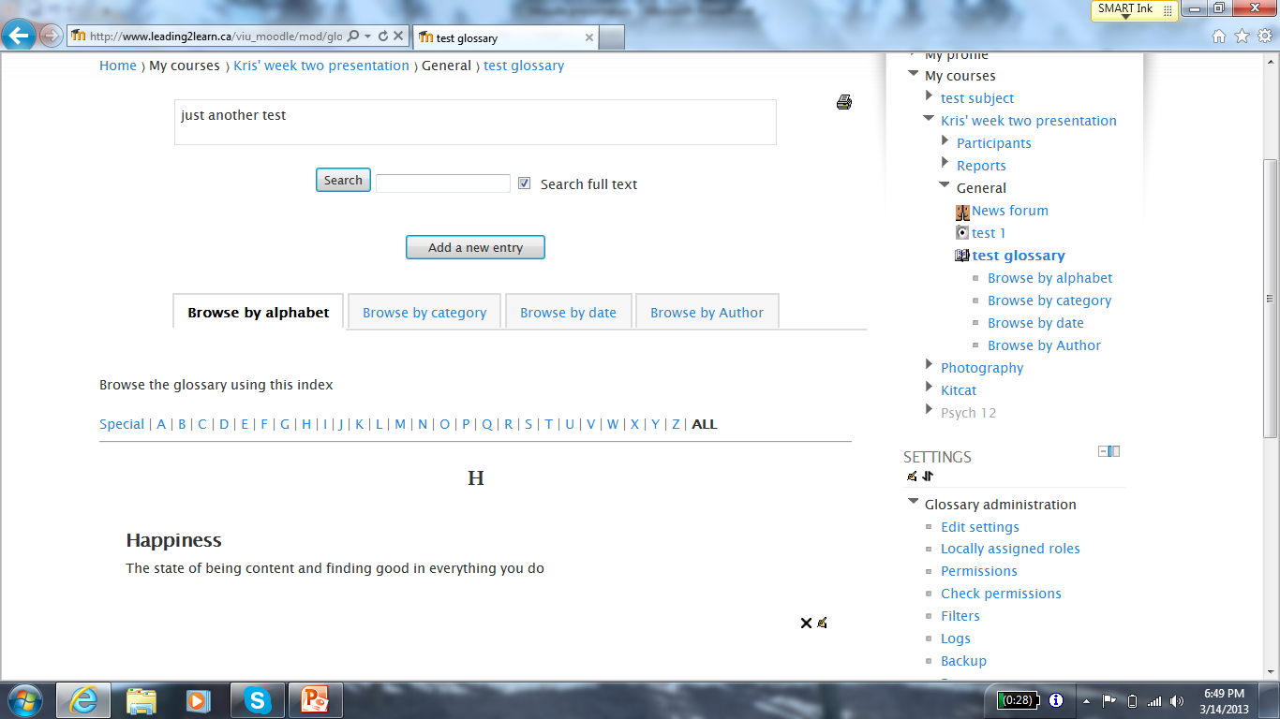

Slide 16
Quick Review
Simple and straightforward – to add a glossary or survey, simply choose “Add an activity” and add the one that you want, then modify it to your liking and save it.
Any questions before I show you in a quick application share? Do we need an application share?

Slide 17
Tasks:
Go into your Moodle classroom
Under Topic 1 – add a survey
Take the survey that you chose – just to test
Under Topic 2 – add a glossary
Find the first letter of your name and add an entry defining yourself in two sentences or less
I’ll set the timer for 10 minutes and we will come back for questions….
….if you finish early you get an extra break!

Slide 18
Questions and Wrap Up
Any questions? I’ll try my best to answer them.
Any parting thoughts before we move on to the next presenter?
Quick bathroom break and time for a cup of tea?
Thank you! ☺

