Slide 1
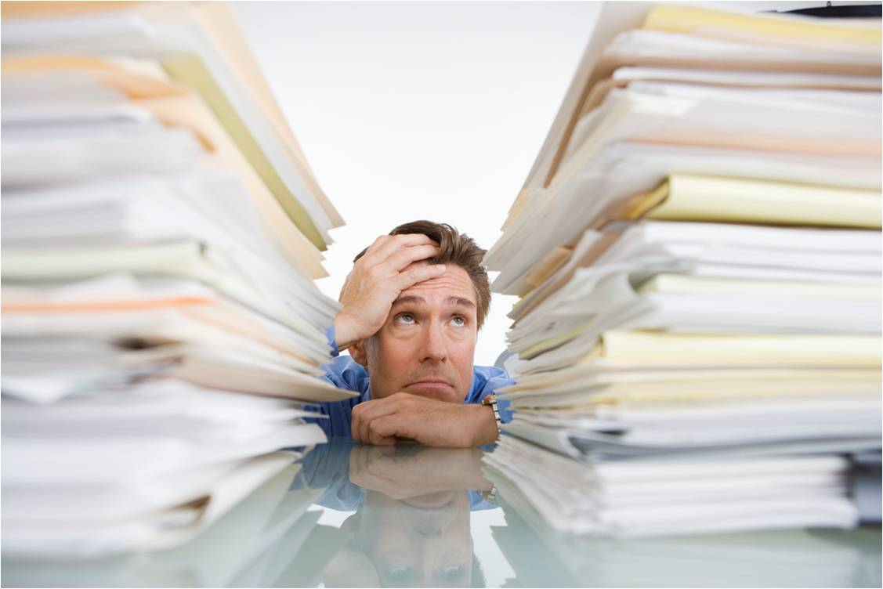
TOO MUCH INFORMATION
By Jane C. and Kris
Click here ☺

Slide 2
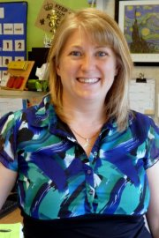
This area is for your picture and a quick intro so she can hear your voice, too. ☺
1
2
3

Slide 6
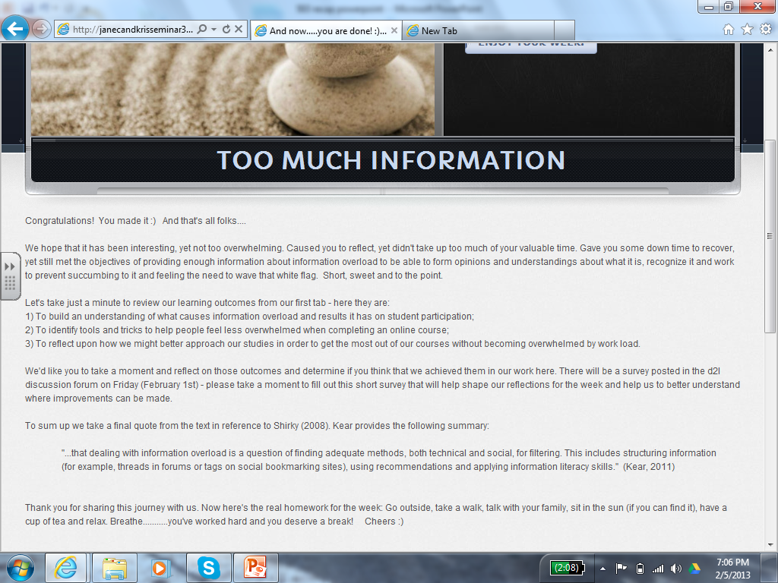
“Now here’s the real homework for the week: Go outside, take a walk, talk with your family, sit in the sun (if you can find it), have a cup of tea and relax. Breathe…..you’ve worked hard and you deserve a break!”

Slide 7
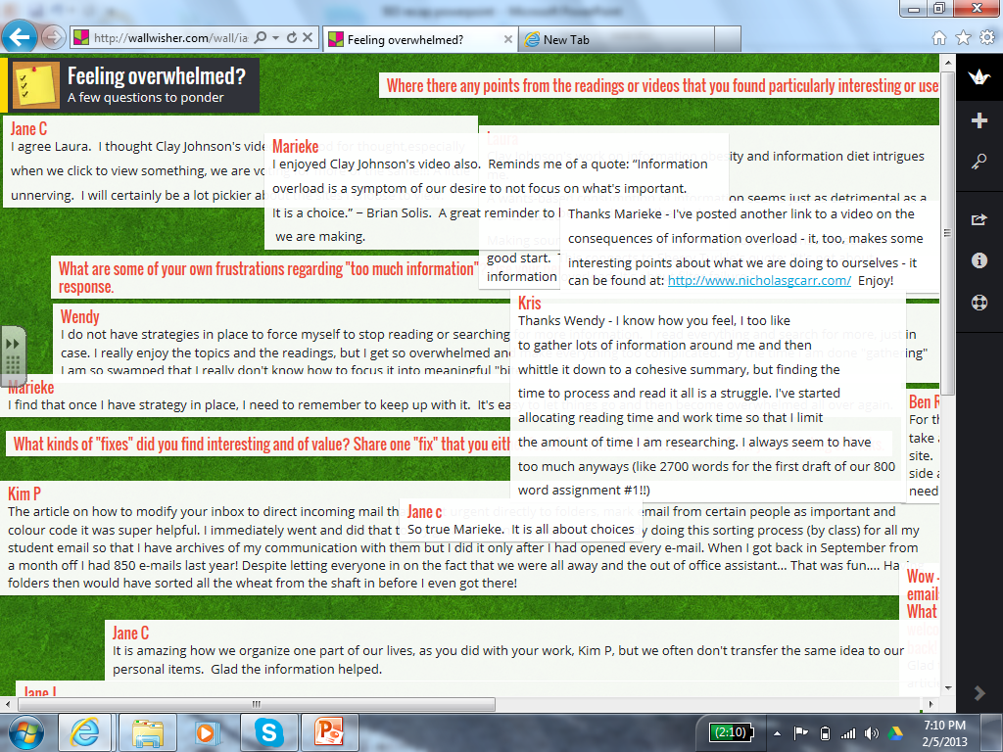

Slide 8
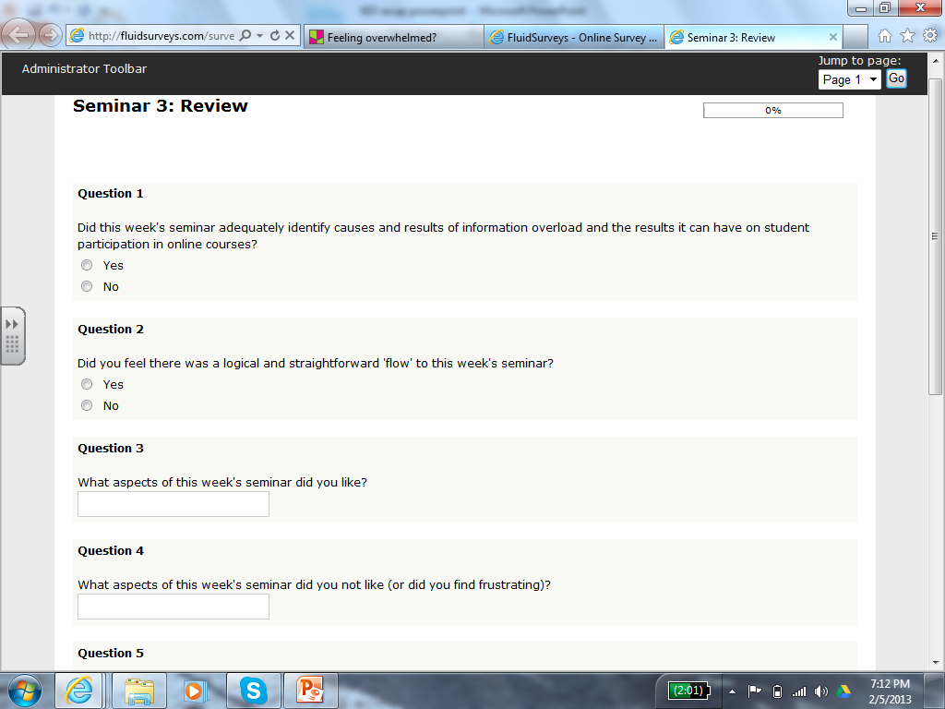
“You guys did a fantastic job. Loved that you tried something new. Love, love, love that it [didn’t] add to ‘information overload’. Thanks so much!”
“Loved the organization of the Weebly site as well as the videos and readings. I find visuals and multimedia engage me as a learner.”
“Some sense of community as you sent regular check ins and the wall help[ed] me feel connected.”

Slide 11
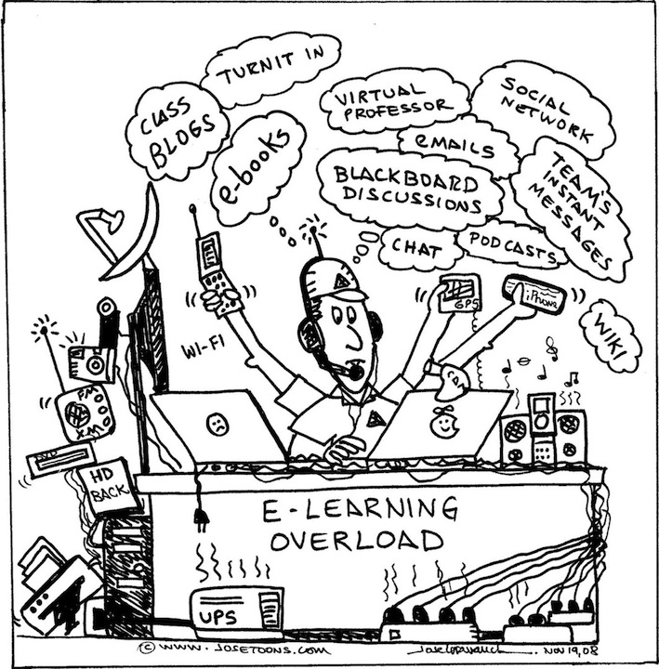

Slide 15
References
Feeling Overwhelmed? (2013). Wallwisher.com. Retrieved February 5, 2013.
http://wallwisher.com/wall/iasiaj176g
Kear, K. (2011). Online and social networking communities: A best practice guide for educators. New York, NY: Routledge.
Online Course Sparks Flood of Emails. (2013). The Times Colonist. Retrieved February 5, 2013.
http://www.timescolonist.com/opinion/letters/online-course-sparks-flood-of-emails-1.64674
Seminar 3 Review. (2013). Fluid Surveys. Retrieved February 5, 2013. http://fluidsurveys.com/account/
Too Much Information. (2013). Weebly.com. Retrieved February 5, 2013. http://janecandkrisseminar3.weebly.com/

