Slide 1
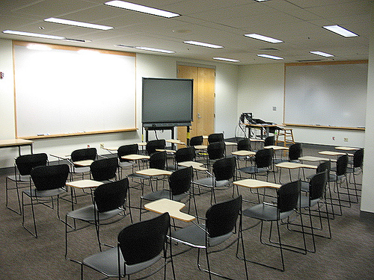
Does learning take place differently in online and blended learning environments? By Kris and Sonny
http://www.flickr.com/photos/newfilm/6600657455/sizes/m/in/photostream/ http://www.flickr.com/photos/osuvalleylibrary/463492446/sizes/m/in/photostream/

Slide 2
As a starting off point, we thought that we would review my Pecha Kucha slideshow as it ties directly in to our discussions and thoughts presented here…..sit back and enjoy for a moment my initial thoughts of teaching online…..

Slide 3
Imagine….by Kris Sward
I can’t imagine teaching online…….
http://www.flickr.com/photos/a-lish147/5021241570/sizes/m/in/photostream/

Slide 4
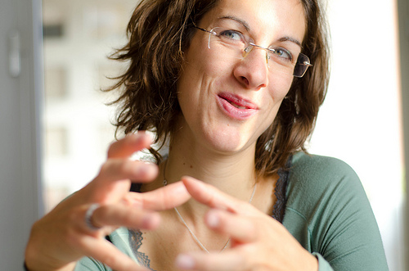
Wait – I can explain…
I mean in my classroom I can do a lot of things!
http://www.flickr.com/photos/nalbertini/6317803326/sizes/m/in/photostream/

Slide 5
I can be welcoming to learners of all ages and backgrounds...
http://www.flickr.com/photos/mjparnell/435465575/

Slide 6
…I am supportive of my students, whatever their
struggles or situations…
http://www.flickr.com/photos/destinysagent/2784119139/sizes/m/in/photostream/

Slide 7
…I am there when they need a little HELP
from their friends…
http://www.flickr.com/photos/oxton/29721662/sizes/m/in/photostream/

Slide 8
…I always try to motivate them and cheer them on…
http://www.flickr.com/photos/pcw_1333/1139029795/sizes/m/in/photostream/

Slide 9
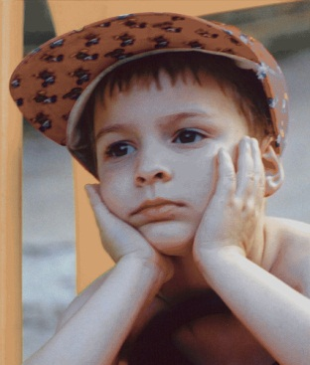
…I am patient with them and encourage them to problem solve for themselves…
http://www.flickr.com/photos/plasticrevolver/46486739/sizes/m/in/photostream/

Slide 10
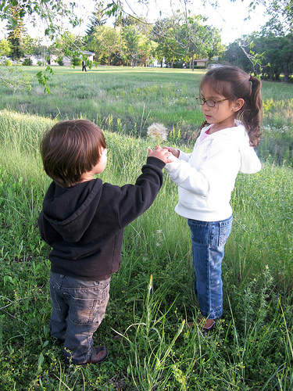
…I encourage them to be kind and respectful to others…
http://www.flickr.com/photos/courosa/3708151311/sizes/m/in/photostream/

Slide 11
…I try to create exciting lessons for them…
http://www.flickr.com/photos/bayasaa/2693171833/sizes/m/in/photostream/

Slide 12
…lessons that are also engaging for them and make them want to know more…
http://www.flickr.com/photos/telachhe/4641589345/sizes/m/in/photostream/

Slide 13
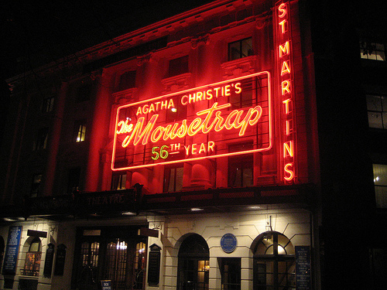
…lessons that are perhaps a bit…mysterious…
http://www.flickr.com/photos/aroberts/3032490151/sizes/m/in/photostream/

Slide 14
…and let’s not forget funny and entertaining…
http://www.flickr.com/photos/everydayelsie/3612303318/sizes/m/in/photostream/

Slide 15
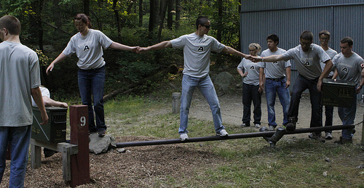
…I encourage my students to collaborate to solve problems…
http://www.flickr.com/photos/west_point/5818583334/sizes/m/in/photostream/

Slide 16
…I try to inspire them to want to do new things and learn more…
http://www.flickr.com/photos/davidyuweb/6974933121/sizes/m/in/photostream/

Slide 17
…and challenge them to go further than they ever thought they could…
http://www.flickr.com/photos/west_point/6257369389/sizes/m/in/photostream/

Slide 18
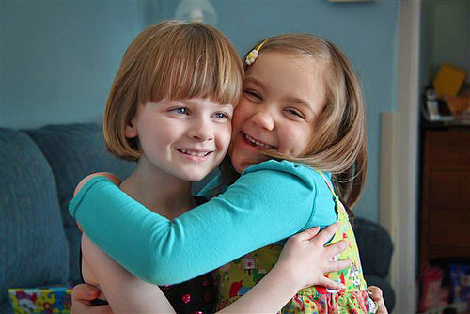
…I reassure them when they doubt themselves or don’t think they can do it…
http://www.flickr.com/photos/clover_1/5380803053/sizes/m/in/photostream/

Slide 19
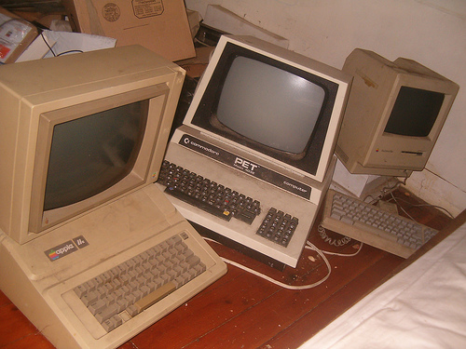
OLTD
…I am innovative…
http://www.flickr.com/photos/eurleif/255241547/sizes/m/in/photostream/

Slide 20
…creative…
http://www.flickr.com/photos/slurm/3546246044/sizes/m/in/photostream/

Slide 21
…and open to change…
http://www.flickr.com/photos/freefoto/3239197673/sizes/m/in/photostream/

Slide 22
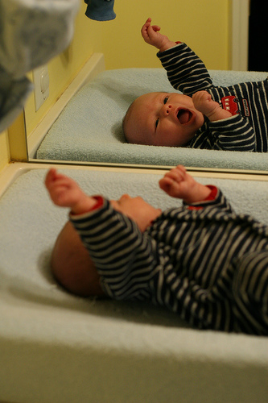
I am already doing all of these things… ...and I IMAGINE I could also do them online…
Hmmm...
maybe it’s not so different…
Okay –
I can do this!
☺
(I think!)
http://www.flickr.com/photos/robenjoyce/3259443830/sizes/m/in/photostream/

Slide 23
So…..is it really so different teaching online as opposed to teaching in a blended classroom or in a face to face classroom?
Did you get the required readings for the week?
When is our paper due?
We should get together after class…
Another user account!
So much homework!!!
Does anyone know how to compress a video file? ☺
Let’s meet at the caf and talk about the project
How many days until the break?
http://www.flickr.com/photos/ubclibrary/2702161062/sizes/m/in/photostream/

Slide 24
What do you imagine when you hear
the phrase “Online Learning”?
What is it?
In this phrase we could be replace the word “learning” with “technology” and it would mean the same thing to the majority of teachers and students.
Online learning is a spectrum; at one end it can take place in a regular classroom were a teacher uses some tools from the web to enhance the lesson. Or, it could be a completely asynchronous model where student and teacher are not necessarily in the same school, town or country. The content is 100% online and teacher provides support through web 2.0 devices.
There are many degrees of online learning in between these two extremes including synchronous and hybrid models.
(speak the parts in italics, not needed in slide… what do you think?) sounds good….do you have notes to work from?...blue background?

Slide 25
First lets take a bit of a look at the history of distance learning:
http://mcdhaliwal.ca/oltd/historyofdl.html
Once you have finished watching the video please put up a green check

Slide 26
History of Distance Learning:
Late 1800’s – introduction of a large correspondence program through the University of Chicago (this was an early attempt to bring a standard level of education to the masses, not just the elite)
1920’s – saw the development of the use of the radio to transmit lessons for distance education (i.e. Wisconsin’s School of the Air)
1950’s – television provides yet another medium with which instructors can deliver distance instruction through recorded lessons distributed with course packages
1970 – the Open University is established in Britain, providing many options and courses for learners at a distance
1980’s – technology is first integrated into distance learning in order to provide instruction more effectively.
Up until this point, distance education was mostly asynchronous, independent study for students who would work through materials at their own pace with sporadic support from either the instructor or peers taking the same course.

Slide 27
1990’s – saw a huge increase in demand and use of distance education
1998 – the Bipartisan Web-based Education Commission (U.S.) was created to investigate the potential use of the internet for distance education
2001 – the Internet Equity and Education Act opened the door for fully online instruction for credit throughout the U.S. by removing restrictions regarding minimal face to face class time limits and the use of student loans for online educational offerings
Present day – online learning provides opportunities for synchronous activities in an online environment where students can choose their courses, work through them at their own pace with or without the support of a cohort, attend live classes fully online, chat or video conference with their instructors and peers, connect outside of regular class time for support or to complete project work, create projects and work through assignments to hand in online and work through an entire program without having to set foot on an actual campus. Distance learning is no longer restricted by issues such as timing, distance, costs of communication or delayed access to learning materials
(Distance Education, Chapter 14, Charlotte Gunawardena and Marina McIsaac, p356/7)

Slide 28
Transactional distance defines distance not as a geographical phenomenon but as a pedagogical phenomenon… Distance is determined by the amount of dialog which occurs between the learner and the instructor, and the amount of structure which exists in the design of the course. (Gunawardena and McIsaac p361)
i.e. just because you are physically in the same room does not mean that you are make a connection with the students. Many times you will see students texting, talking with friends may even have a deck of cards. The students might as well not be in the classroom.

Slide 29
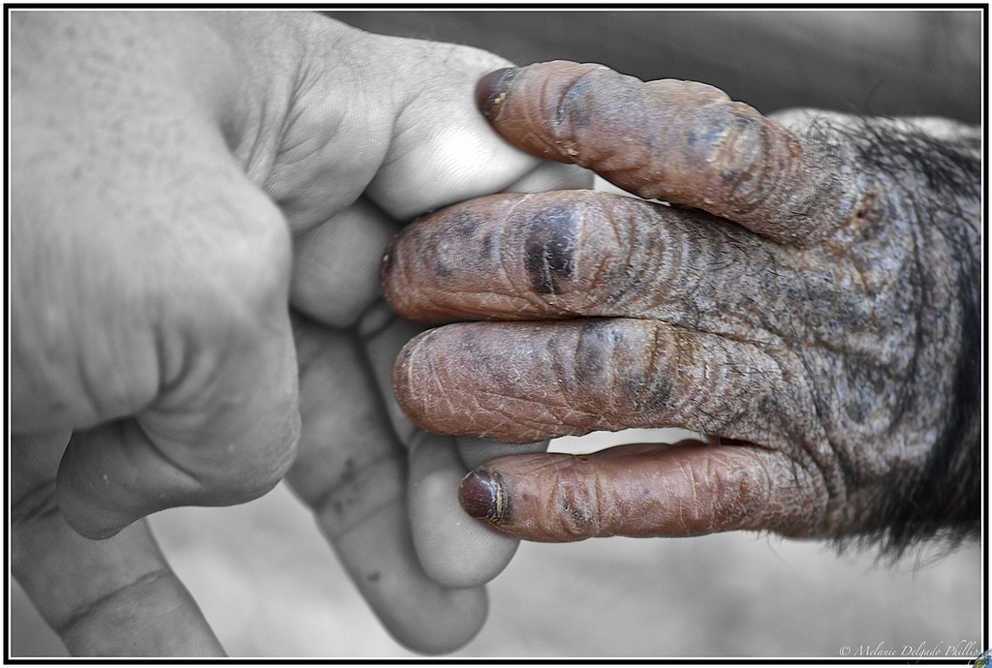
One of the big complaints about online studies is the lack of interactions.
According to Anderson interactions can even be simulated (Anderson p55)
Before we criticize we need to determine what are meaningful interactions?

Slide 30
Interactions occur when objects and events mutually influence one another (Anderson p55)
In the process of learning there are 3 types of interactions:
learner-content
learner-instructor
learner-learner
(Gunawardena and McIsaac p362)

Slide 31
Learner – Content
How does this look in the classroom?
Teacher guided discussion and lessons
Student lead Presentations
Explorations
How does this look in an online environment?
Video tutorials
Interactive simulations
Self exploration
Guided explorations
Demonstration of knowledge(presentations, blogs, video projects, labs, etc)
http://www.flickr.com/photos/donkeyhotey/5713922088/sizes/m/in/photostream/

Slide 32
different tools but achieving the same goal

Slide 33
Learner – learner
How does this look in the classroom?
Group Projects
Pair learning
Labs
Games
How does this look in an online environment?
Discussion Groups (via software like first class)
Collaborate
Blogs (nothings says that in order for it be meaningful it needs to be synchronous)
Social Networking (Facebook, twitter, etc)
http://www.flickr.com/photos/n3k/3108481610/sizes/m/in/photostream/

Slide 34
different tools but achieving the same goal

Slide 35
Learner – teacher
How does this look in the classroom?
Tutorial sessions
Classroom time
How does this look in an online environment?
Emails
Phone/Skype
Collaborate
Face to Face Meetings (yes that can still happen if you choose online studies)
http://www.flickr.com/photos/benrussell/1477899923/sizes/m/in/photostream/

Slide 36
different tools but achieving the same goal

Slide 37
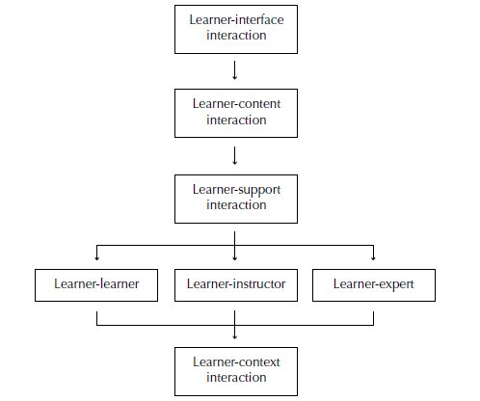
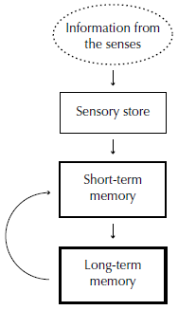
There are many theories for learning, most teachers find that they incorporate each one of these theories in their practice (at least to varying degrees). In the readings it gives implications for online learning, however when I read the implications I found that they just did not apply to online but equally to the classroom, They were best practice period.
Constructivist
Cognitivist
connectivitst
Behaviorist

Slide 38
Issues (maybe talk about some of these)…can we make some more slides like those that follow showing similarities and differences? Do we need to?
In an asynchronous model, motivation, staying on pace can be a problem
When having a F2F conversation with a person, there are a lot cues that we pick up from expressions that we just don’t get in an online setting
Synchronous and hybrid models may result in the best overall success, however this is not a one shoe fits all scenario and there is a place for asynchronous learning.
There will always be issues with every model, including the classroom model. However learning is learning, and really doesn’t matter on the delivery model

Slide 39
What is needed for a lesson to be successful?
Organization (scaffolding)
Motivatation – make it meaningful
Variety
Connections with past experiences
Feedback
Along as these objectives are meet, doesn’t matter if you are online on F2F the student will learn.
(Anderson p23-28)
(move to the end??) I’m thinking yes…perhaps after slide 44?

Slide 40
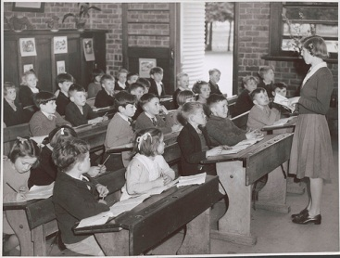
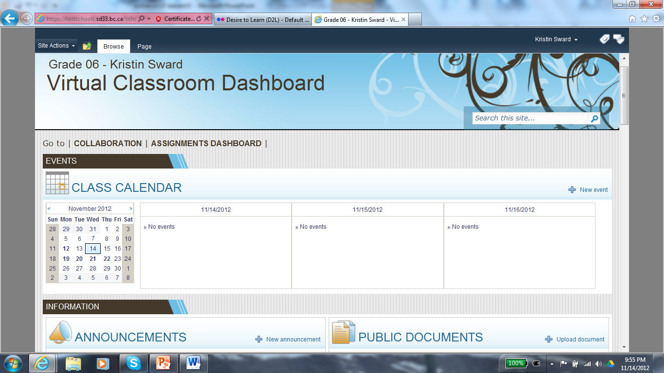
So whereas Online Learning presents some challenges not seen in a face to face classroom it also alleviates some challenges teachers typically deal with. Online Learning uses some pretty amazing tools to reach the same objectives teachers in the classroom face.
1) Classroom Management
http://www.flickr.com/photos/national_library_of_australia_commons/6173548853/sizes/m/in/photostream/

Slide 41
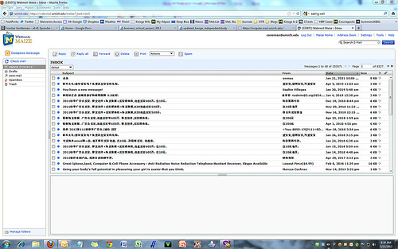
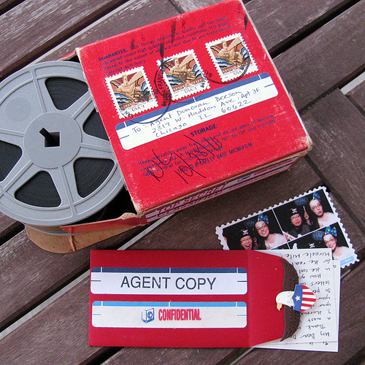
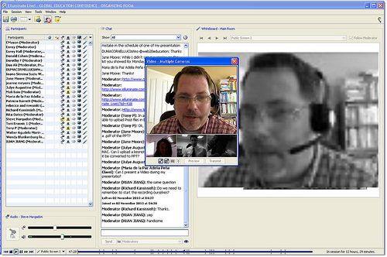
2) Communication
http://www.flickr.com/photos/donovan_beeson/5152465861/sizes/m/in/photostream/
http://www.flickr.com/photos/cseeman/7248554610/sizes/m/in/photostream/
http://www.flickr.com/photos/raster/3071133748/sizes/m/in/photostream/
http://www.flickr.com/photos/24289877@N02/5181047860/sizes/m/in/photostream/

Slide 42
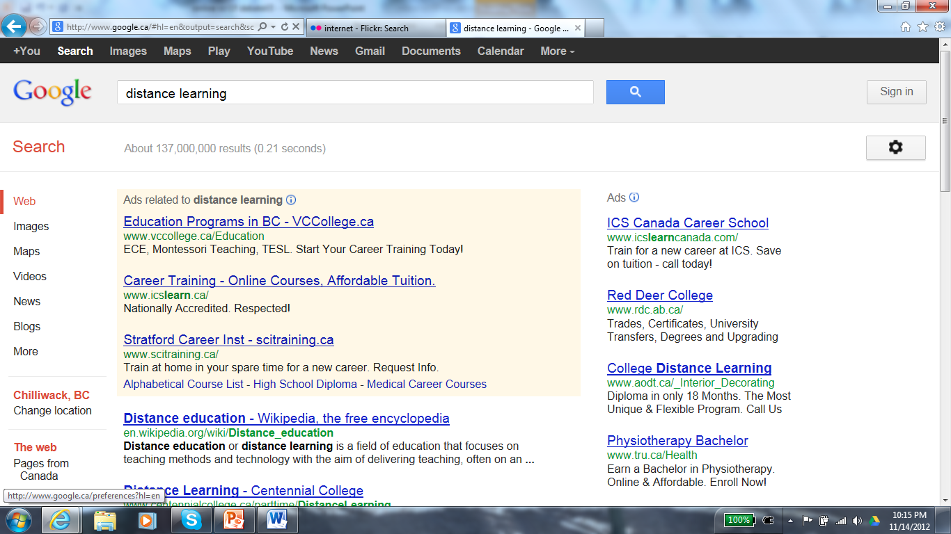
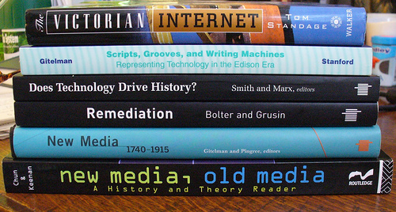
3) Resources
(137 000 000 hits for Distance Learning!!)
http://www.flickr.com/photos/slimcoincidence/406910873/sizes/m/in/photostream/

Slide 43
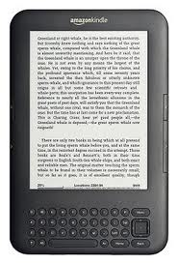
4) Meeting the needs of individual learners

Slide 44
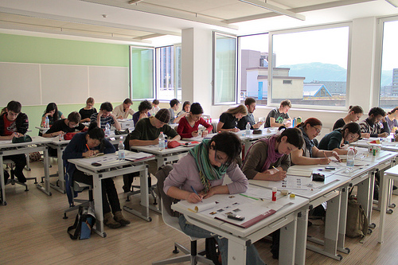
5) Relevance
Is this really how you want to learn?
http://www.flickr.com/photos/zeligdoc/4536875415/sizes/m/in/photostream/

Slide 45
Perhaps traditionally Distance Learning was in it’s own world and required it’s own theories, but with the advent of computer technology that increases interaction between the learner and the instructor, as well as other learners, and allows for synchronous, enriched learning activities and connections.....things have changed. No longer is Distance Learning in a world of it’s own with it’s own set of challenges and unique benefits. In short, it’s just a different tool achieving the same goal.
“Technological advances have already begun to blur the distinction between traditional and distance education settings.”
(“Gunawardena and McIsaac, p363)

Slide 46
The reality of Distance Education today…..
…..anytime, anywhere, anyhow…..

Slide 47
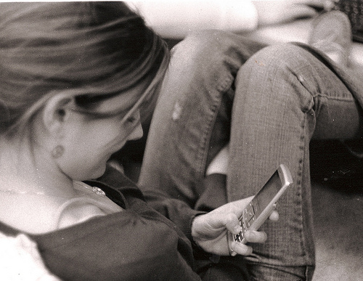
Any questions? Comments? Concerns?
http://www.flickr.com/photos/themegster/3363714747/sizes/m/in/photostream/

